Slide 1


WorkConnect: On-Demand Service Worker Platform
Revolutionizing how people find and hire skilled workers.

Slide 2

Pros: Convenience and Efficiency
1
24/7 Availability
2
Streamlined Hiring
Access skilled workers anytime, anywhere.
Simplified process saves time and effort.
3
Diverse Skill Pool
Wide range of services in one place.

Slide 3

Cons: Quality Control Challenges
1
Verification Issues
2
Inconsistent Quality
Difficulty ensuring worker qualifications and reliability.
Varied service standards across different workers.
3
Trust Building
Overcoming user skepticism in online hiring.

Slide 4
Pros: Economic Opportunities
Worker Flexibility
Income Generation
Market Expansion
Choose jobs and hours freely.
New earning avenues for skilled individuals.
Connect workers to broader customer base.

Slide 5

Cons: Platform Dependency
1
Commission Costs
Platform fees may reduce worker earnings.
2
Algorithm Reliance
Job visibility dependent on platform's matching system.
3
Data Privacy Concerns
Handling sensitive user and worker information.

Slide 6




Pros: Community Building
Local Connections
Foster relationships between neighbors and local workers.
Reputation System
Build trust through reviews and ratings.
Skill Sharing
Platform for knowledge exchange and mentorship.

Slide 7




Cons: Market Saturation
Increased Competition
Overflow of workers may lead to underemployment.
Price Pressure
Race to the bottom for service pricing.
Quality Dilution
Influx of inexperienced workers affects overall standards.

Slide 8
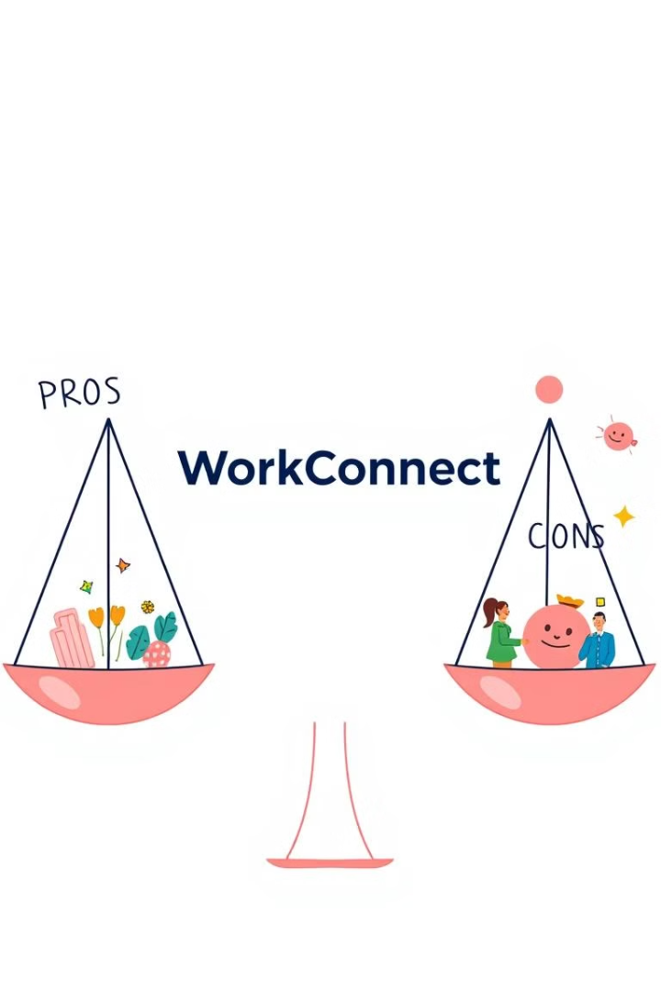
Balancing Opportunities and Challenges
Pros
Cons
Convenience
Quality Control
Economic Growth
Platform Dependency
Community Building
Market Saturation

